Slide 1
SSZG518: Database design and Applications Ms. Uma Maheswari

Slide 2
Session 8
Data storage and access methods

Slide 3
LEARNING OUTCOME
Secondary storage devices
Files, records, blocks on disks
Hashing techniques(internal & external)
REFER: T1-Chapter 13
Sections: 13.1-13.8

Slide 4
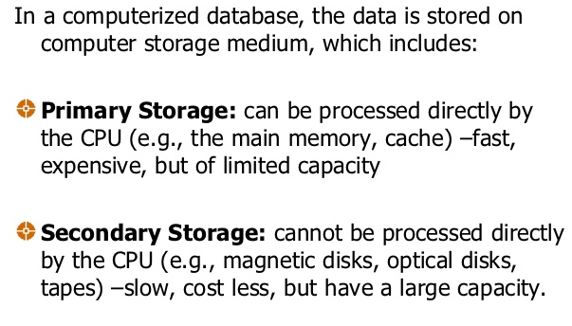
Introduction

Slide 5
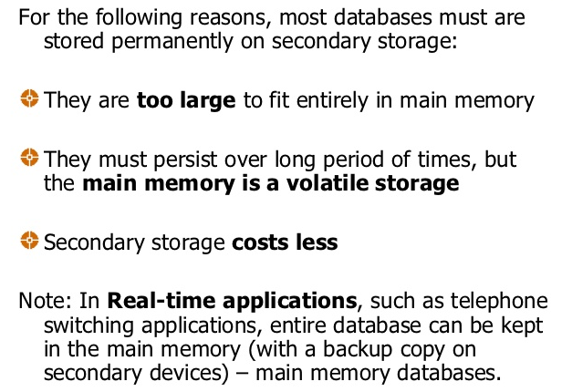
Introduction

Slide 6
SECONDARY STORAGE DEVICES

Slide 7
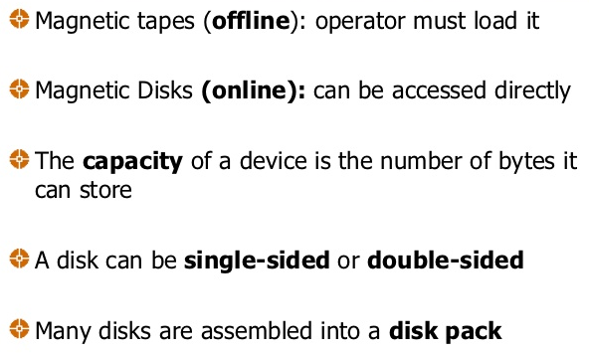
Secondary Storage Devices

Slide 8
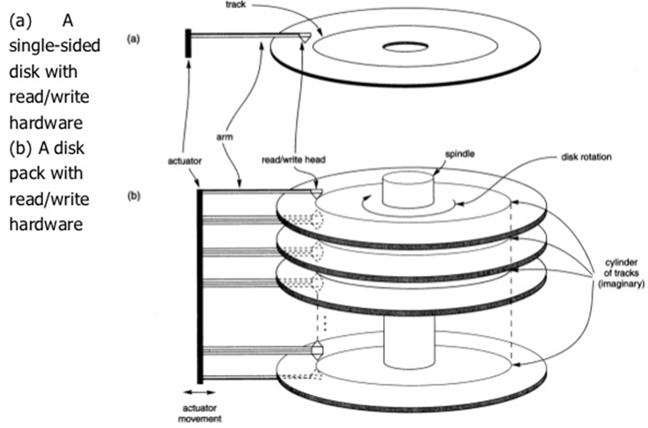
Secondary Storage Devices

Slide 9
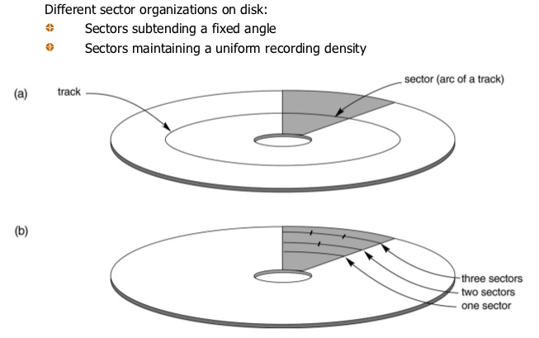
Secondary Storage Devices

Slide 10
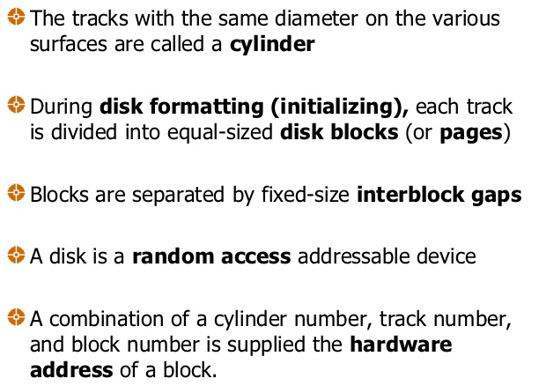
Secondary Storage Devices

Slide 11
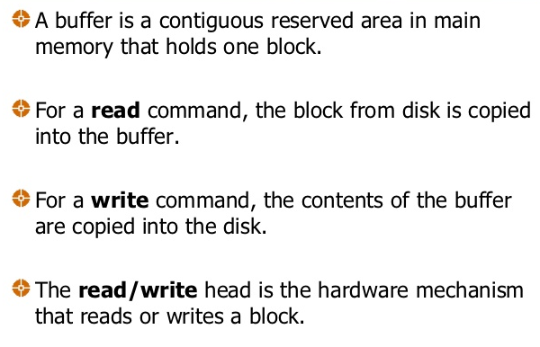
Secondary Storage Devices

Slide 12
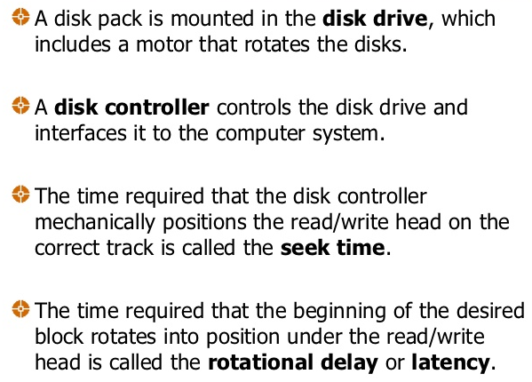
Secondary Storage Devices

Slide 13
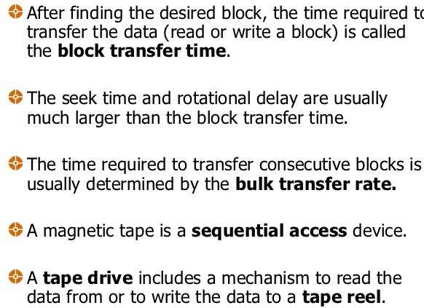
Secondary Storage Devices

Slide 14
Disk Parameters Calculation:
Usually, the disk manufacturer provides an average seek time in milliseconds.
The typical range of average seek time is 4 to 10 msec.
If the speed of disk rotation is p revolutions per minute (rpm), then the average
rotational delay rd is given by
rd = (1/2) * (1/p) min= (60 * 1000)/(2 * p) msec = 30000/p msec.
Block transfer time (btt) = B/tr msec where B is Block size and tr is transfer rate.
Transfer rate = track size in bytes / 1 rpm.
The average time (s) needed to find and transfer a block, given its block address, is estimated by (s + rd + btt) msec.

Slide 15
Disk Parameters Calculation:
To transfer consecutively k noncontiguous blocks that are on the same cylinder, we need approximately s + (k * (rd + btt)) msec.
The rotational delay for all but the first block, so the estimate for transferring k consecutive blocks is s + rd + (k * btt) msec.
bulk transfer rate (btr) that takes the gap size into account when reading consecutively stored blocks. If the gap size is G bytes, then
btr = (B/(B + G)) * tr bytes/msec.
The estimated time to read k blocks consecutively stored on the same cylinder becomes s + rd + (k * (B/btr)) msec.

Slide 16
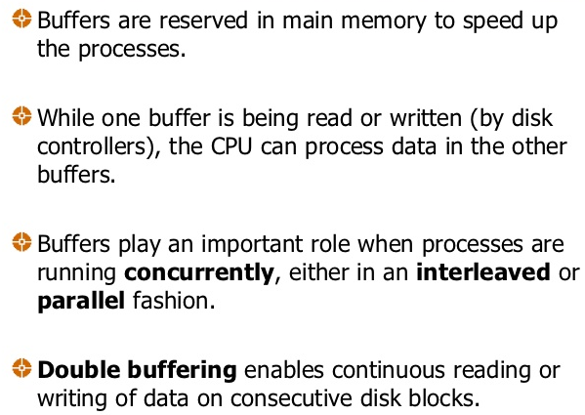
Buffering of Blocks

Slide 17
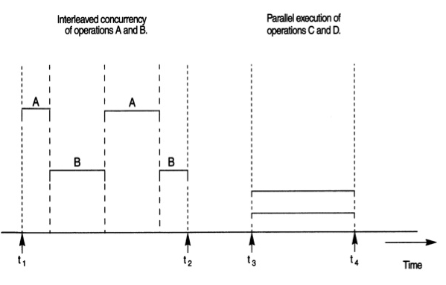
Buffering of Blocks

Slide 18
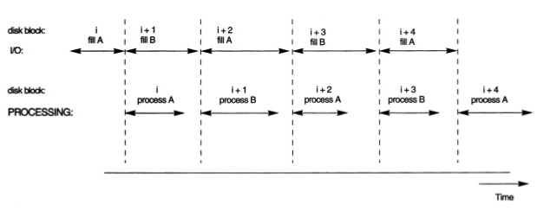
Buffering of Blocks

Slide 19
FILES AND RECORDS

Slide 20
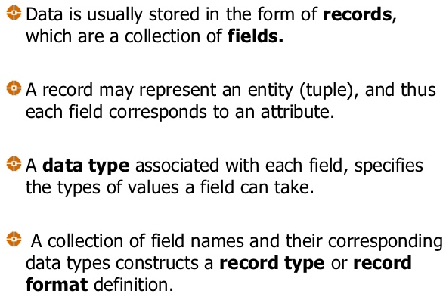
Placing file records on Disk

Slide 21
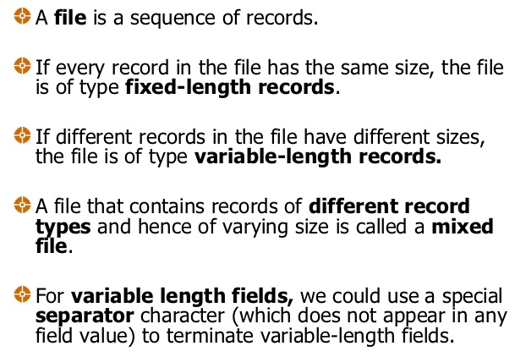
Placing file records on Disk

Slide 22
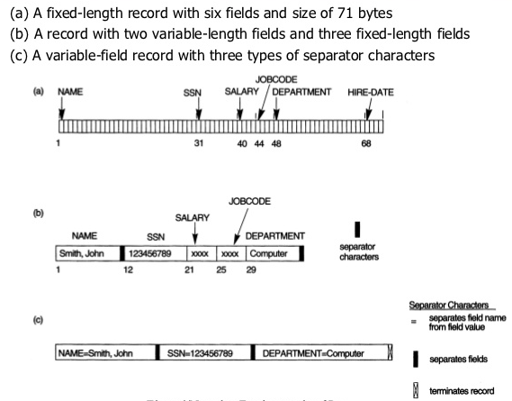
Placing file records on Disk

Slide 23
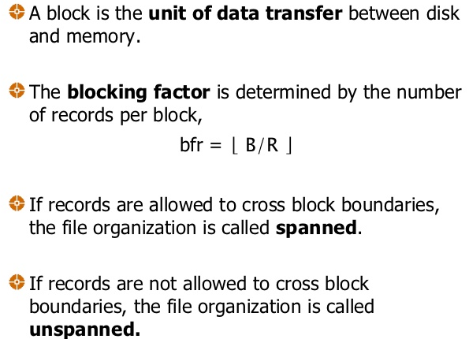
Placing file records on Disk

Slide 24
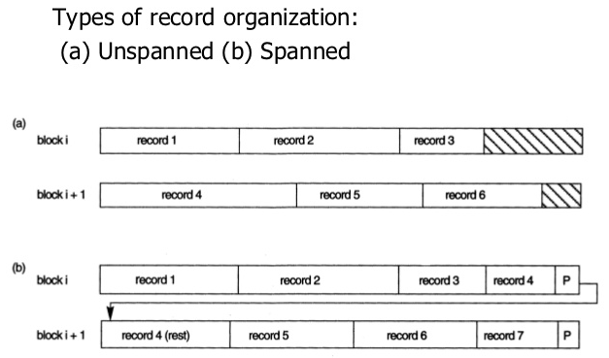
Placing file records on Disk

Slide 25
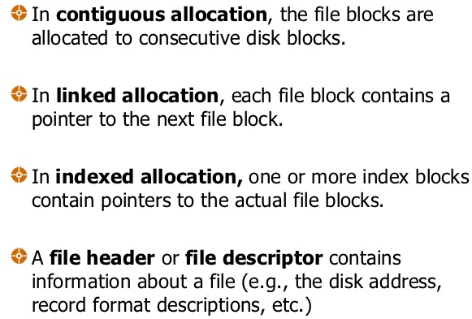
Placing file records on Disk

Slide 26
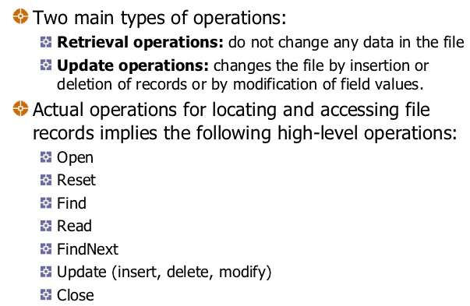
Operations on files

Slide 27
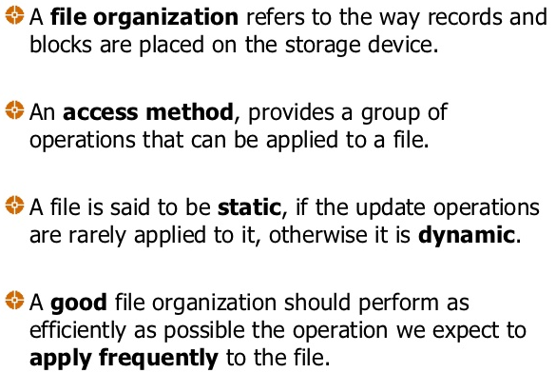
Operations on files

Slide 28
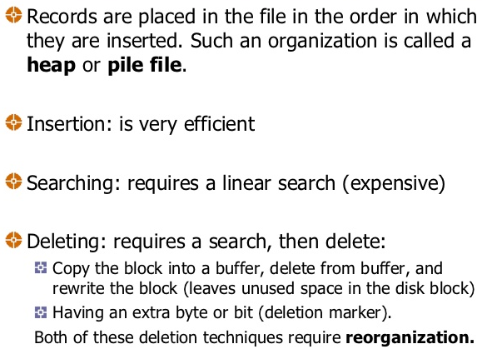
Files of unordered records

Slide 29
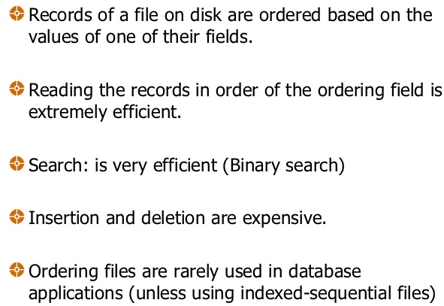
Files of ordered records
A binary search usually accesses log2(b) blocks, whether the record is found or not.
While linear searches, where, on the average, (b/2) blocks are accessed when the record is found and b blocks are accessed when the record is not found.

Slide 30
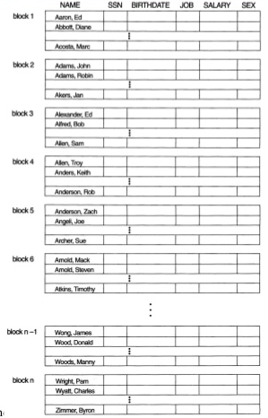
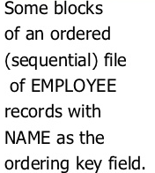
Files of ordered records

Slide 31
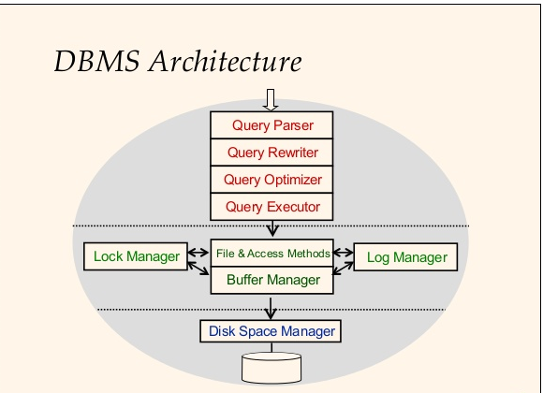
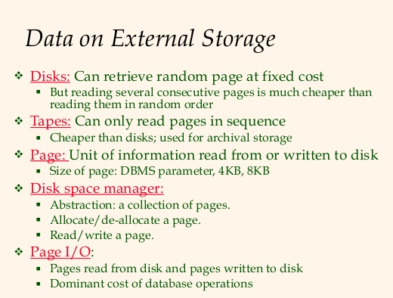
Introduction

Slide 32
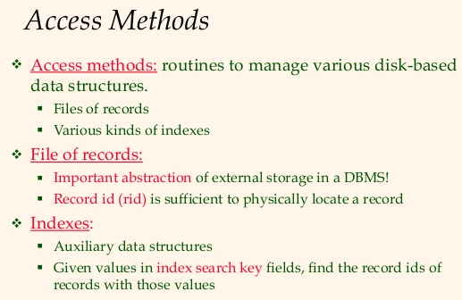
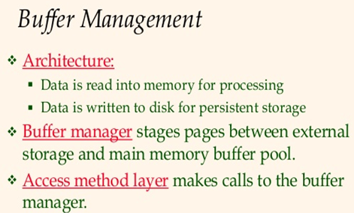
Introduction

Slide 33
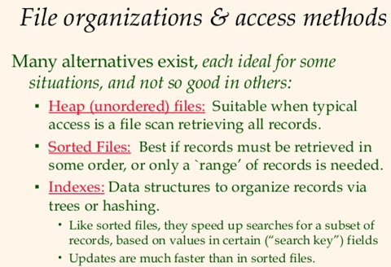
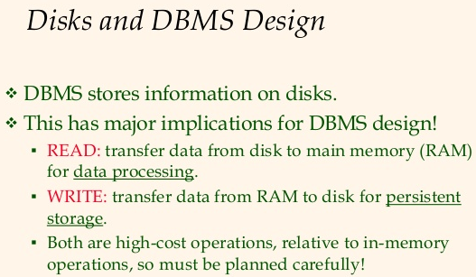
Introduction

Slide 34

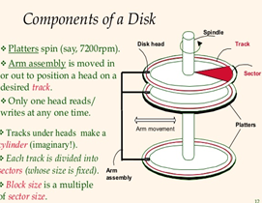
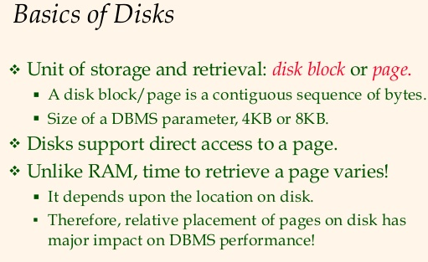
All about Disk

Slide 35
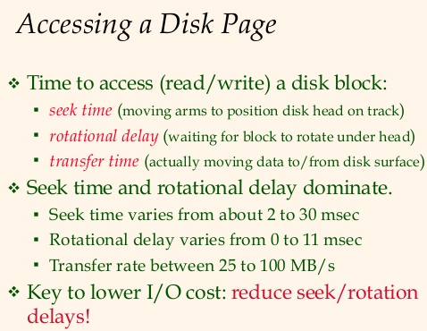
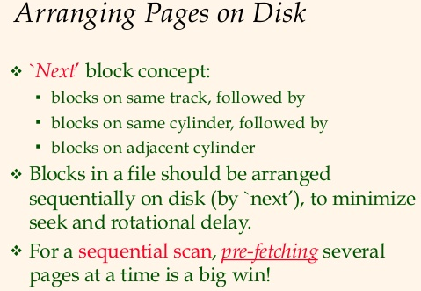
Disk and Pages

Slide 36
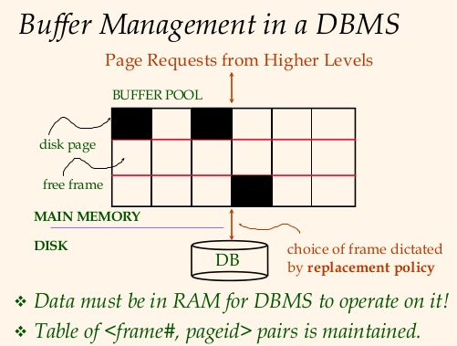
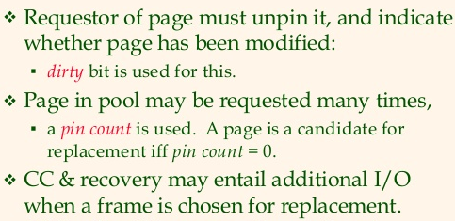
Buffer mgmt

Slide 37

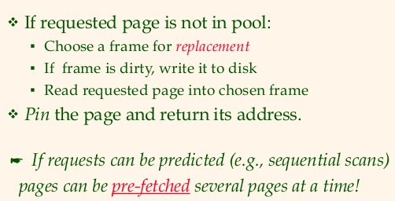
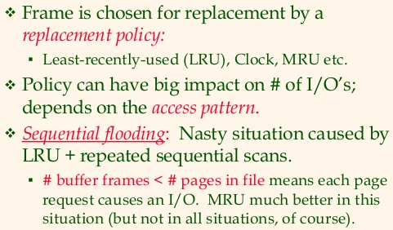
How a page is fetched from disk and brought into RAM ?

Slide 38
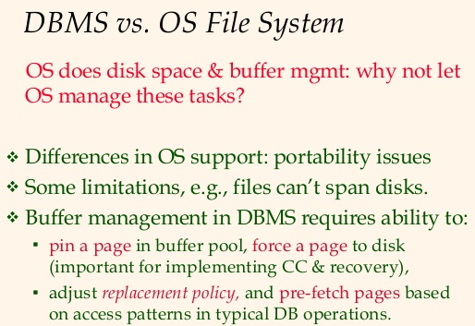
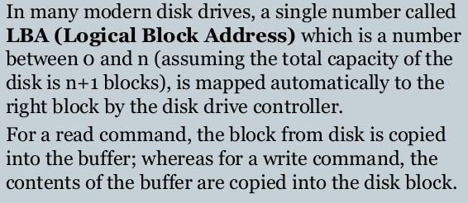
Then what is the ROLE of OS?

Slide 39
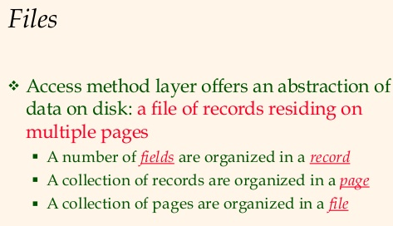
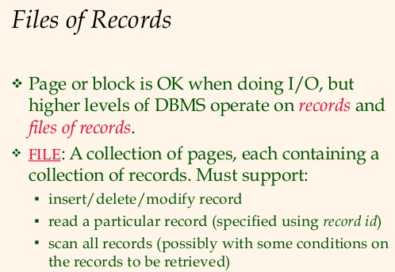
Files

Slide 40
Question?
Without rearranging the actual records can you put them in particular order based on a key field or fields?
Sol:
By Indexing or Hashing.
Indexing is like Index at the end of Book , so you need to search linearly or binary to get to that term and find page number where that term is in the book. So catch is file (actual data) and a index to it is needed.
Hashing is O(1) doesn’t need to search but computes the data location in the file.

Slide 41
HASHING TECHNIQUE

Slide 42
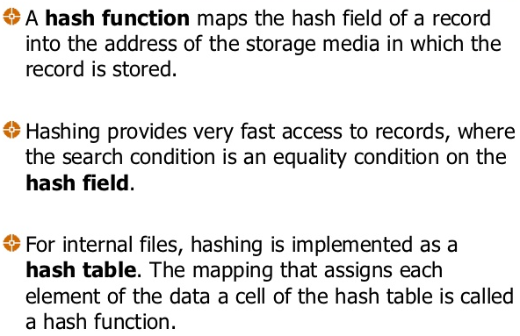
Hashing Technique

Slide 43
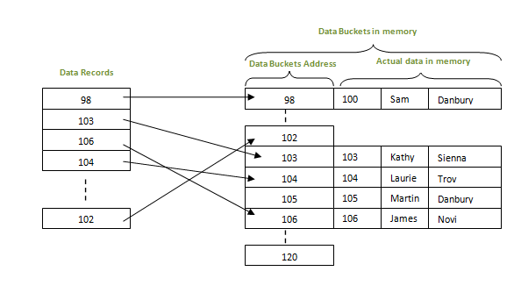
where data is stored at the data blocks whose address is generated by using hash function. The memory location where these records are stored is called as data block or data bucket. This data bucket is capable of storing one or more records.

Slide 44
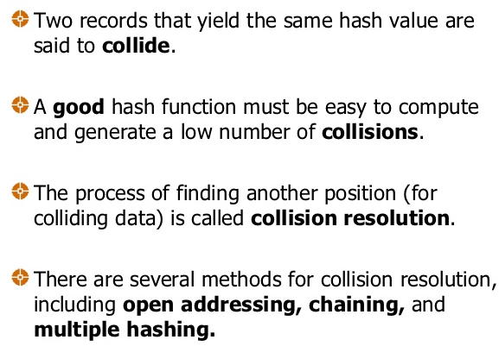
Hashing Technique

Slide 45
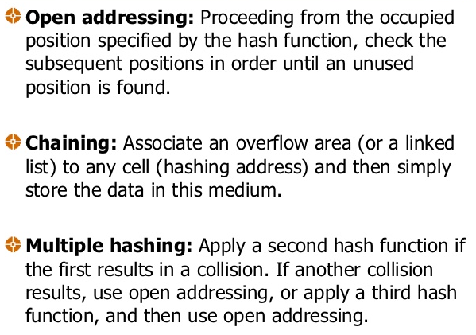
Hashing Technique

Slide 46
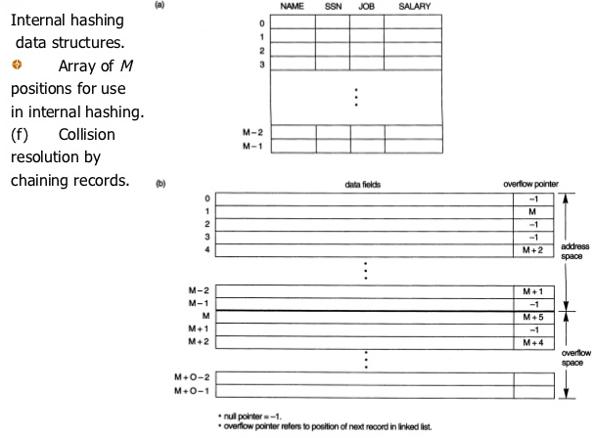
Hashing Technique

Slide 47
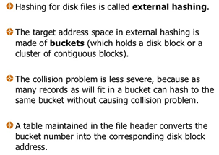
Hashing Technique

Slide 48
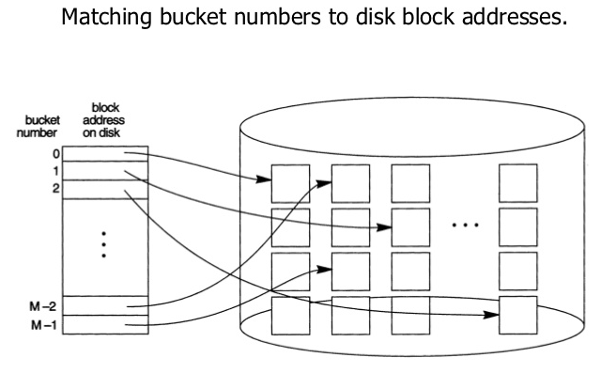
Hashing Technique

Slide 49
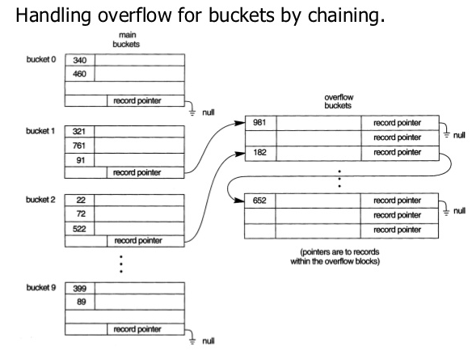
Hashing Technique

Slide 50
Types of Hashing
Hashing are of two types:
1. Internal Hashing
2. External Hashing

Slide 51

Hashing Technique

Slide 52

Structure of extendible hashing

Slide 53

Problem 1
Q: The keys 12, 18, 13, 2, 3, 23, 5 and 15 are inserted into an initially empty hash table of length 10 using open addressing with hash function h(k) = k mod 10 and linear probing. What is the resultant hash table?
A: Keys 12, 18, 13, 2, 3, 23, 5 and 15 are inserted in hash table as:
For key 12, h(12) is 12%10 = 2. Therefore, 12 is placed at 2nd index in the hash table. For key 18, h(18) is 18%10 = 8. Therefore, 18 is placed at 8th index in the hash table. For key 13, h(13) is 13%10 = 3. Therefore, 13 is placed at 3rd index in the hash table. For key 2, h(2) is 2%10 = 2. However, index 2 is already occupied with 12. Therefore, using linear probing, 2 will be placed at index 4 as index 2 and 3 are already occupied. For key 3, h(3) is 3%10 = 3. However, index 3 is already occupied with 13. Therefore, using linear probing, 3 will be placed at index 5 as index 3 and 4 are already occupied. Similarly, 23, 5 and 15 will be placed at index 6, 7, 9 respectively.

Slide 54
Sample questions

Slide 55
Question 1
Let us say we have XAT supplier company has stored info on files.
A Supplier file has rec = 1000 records of fixed length.
Each record has the following fields/cols (in bytes) :
sup# (10), part# ( 10) , pname(200) pdescp(700) and a deletion marker byte.
The file is stored on the disk whose parameters are given as block size B = 1024 bytes; interblock gap size G = 200bytes; number of blocks per track = 25; number of tracks per surface = 500. A disk pack consists of 18 double-sided disks.
a. Calculate the record size in bytes.
b. Calculate the blocking factor and the number of file blocks b, assuming an unspanned organization.
c. Calculate the average time it takes to find a record by doing a linear search on the file if
(i) the file blocks are stored contiguously, and double buffering is used;
(ii) the file blocks are not stored contiguously.
d. Assume that the file is ordered by part#; by doing a binary search, calculate the time it takes to search for a record given its part# value.

Slide 56

Quick review for MIDSEM
Practice Drawing ER or EER
Obtain Relational schema for ER or EER
Practice SQL , Relational Algebra, Tuple calculus and domain Calculus problems.
Learn FD , Armstrong axioms and Inference rules.
To find closure and Keys prime and non prime.
Learn Normalizing the given schema.(1, 2, 3 , BCNF, 4, 5) NFs
Practice to determine the NF of the given schema and converting it higher level schema.
Determining how to calculate File related and Hashing related terms.

Slide 57
THANK YOU

